Slide 1
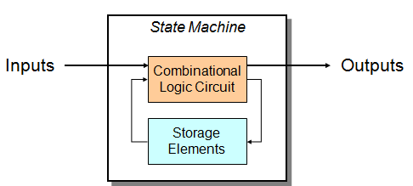
STATE MACHINES
State Machine
Another type of sequential circuit
Combines combinational logic with storage
―Remembers‖ state, and changes output (and state) based on inputs and current state
State
The state of a system is a snapshot of all the relevant elements of the system at the moment the
snapshot is taken.
Examples:
The state of a basketball game can be represented by the scoreboard.
Number of points, time remaining, possession, etc.
The state of a tic-tac-toe game can be represented by the placement of X’s and O’s on the board.

Slide 2
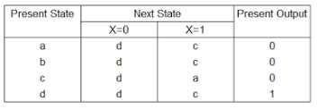
STATE MACHINES
State Tables and State Diagrams
STATE TABLES AND STATE DIAGRAMS
In this model the effect of all previous inputs on the outputs is represented by a state of the circuit. Thus, the output of the circuit at any time depends upon its current state and the input. These also determine the next state of the circuit. The relationship that exists among the inputs, outputs, present states and next states can be specified by either the state table or the state diagram.
State Table
The state table representation of a sequential circuit consists of three sections labeled present state, next state and output. The present state designates the state of flip-flops before the occurrence of a clock pulse. The next state shows the states of flip-flops after the clock pulse, and the output section lists the value of the output variables during the present state.

Slide 3
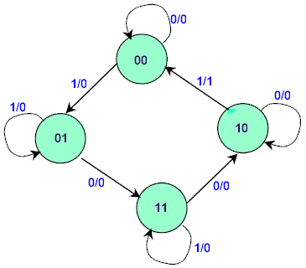
STATE MACHINES
State Diagram
In addition to graphical symbols, tables or equations, flip-flops can also be represented graphically by a state diagram. In this diagram, a state is represented by a circle, and the transition between states is indicated by directed lines (or arcs) connecting the circles.
The binary number inside each circle identifies the state the circle represents. The directed lines are labelled with two binary numbers separated by a slash (/). The input value that causes the state transition is labelled first. The number after the slash symbol / gives the value of the output. For example, the directed line from state 00 to 01 is labelled 1/0, meaning that, if the sequential circuit is in a present state and the input is 1, then the next state is 01 and the output is 0. If it is in a present state 00 and the input is 0, it will remain in that state. A directed line connecting a circle with itself indicates that no change of state occurs. The state diagram provides exactly the same information as the state table and is obtained directly from the state table.
State Diagram

Slide 4
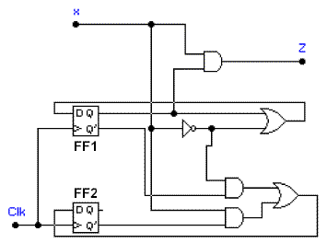
STATE MACHINES
Example:
Consider a sequential circuit
The behavior of the circuit is determined by the
following Boolean expressions:
Z = x*Q1
D1 = x' + Q1
D2 = x*Q2' + x'*Q1'
These equations can be used to form the state table. Suppose the present state (i.e. Q1Q2) = 00 and input x = 0. Under these conditions, we get Z = 0, D1 = 1, and D2 = 1. Thus the next state of the circuit D1D2 = 11, and this will be the present state after the clock pulse has been applied. The output of the circuit corresponding to the present state Q1Q2 = 00 and x = 1 is Z =
0. This data is entered into the state table as shown in Table 2.

Slide 5
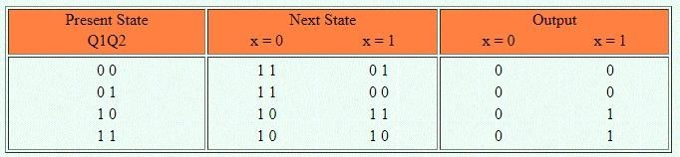
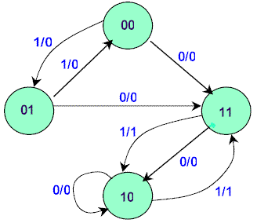
STATE MACHINES
State table for the sequential circuit
The state diagram for the sequential circuit

Slide 6
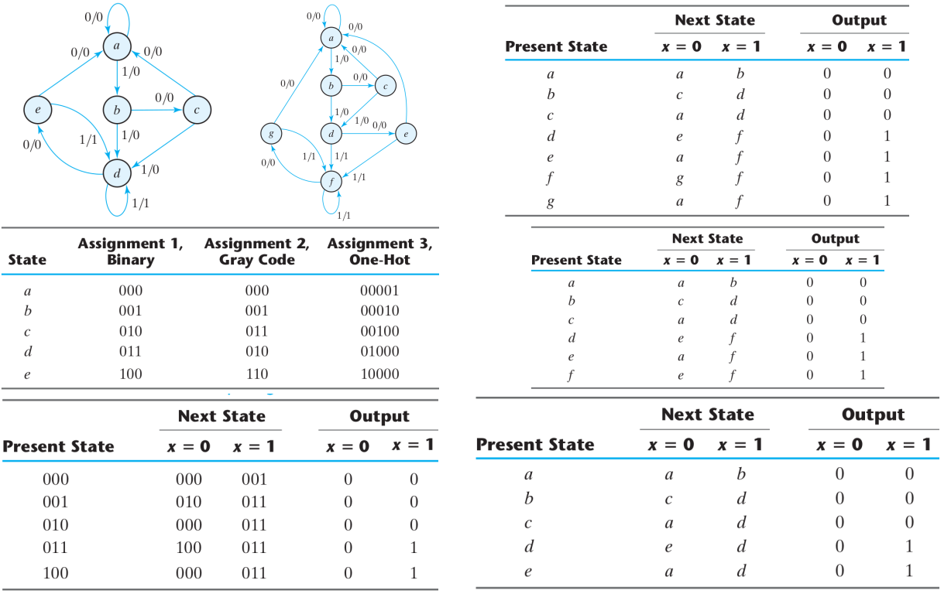
State Reduction and Assignments

Slide 7
The procedure for designing synchronous sequential circuits can be summarized by a list of recommended steps:
From the word description and specifications of
the desired operation, derive a state diagram for
the circuit.
2. Reduce the number of states if necessary.
3. Assign binary values to the states.
4. Obtain the binary-coded state table.
5. Choose the type of flip-flops to be used.
6. Derive the simplified flip-flop input equations
and output equations.
7. Draw the logic diagram.

Slide 8
Suppose we wish to design a circuit that detects a sequence of three or more consecutive 1’s in a string of bits coming through an input line
It is derived by starting with state S0, the reset state.
If the input is 0, the circuit stays in S0, but if the input is 1, it goes to state S1 to indicate that a 1 was detected.
If the next input is 1, the change is to state S2 to indicate the arrival of two consecutive 1’s, but if the input is 0, the state goes back to S0.
The third consecutive 1 sends the circuit to state S3. If more 1’s are detected, the circuit stays in S3. Any 0 input sends the circuit back to S0.
In this way, the circuit stays in S3 as long as there are three or more consecutive 1’s received

Slide 9
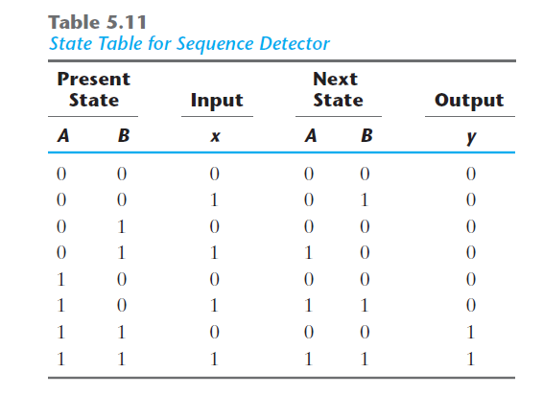
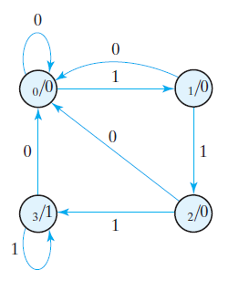

Slide 10
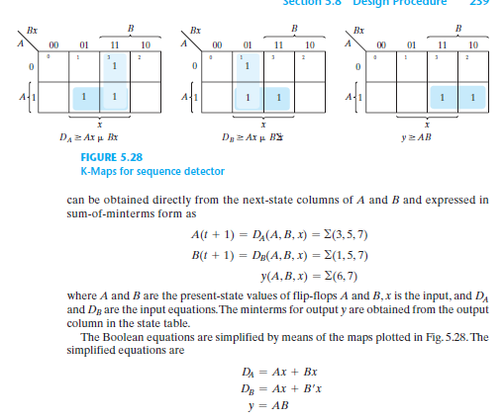

Slide 11
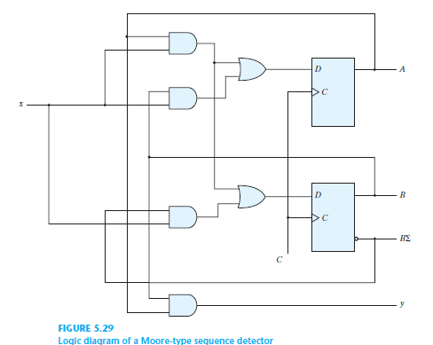

Slide 12
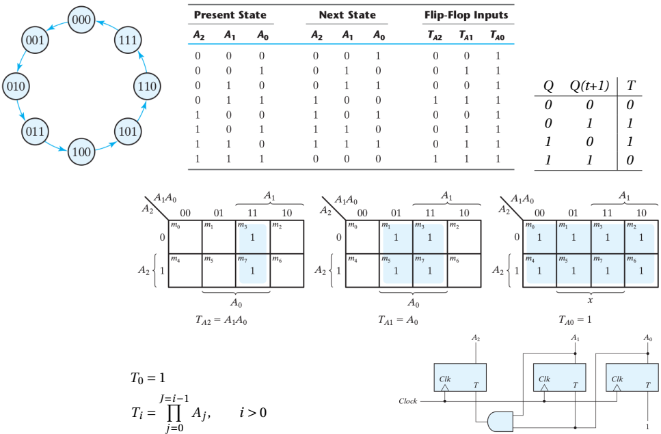
Using a T FF, design a circuit that counts from 0 to 7 compare to D and JK

Slide 13
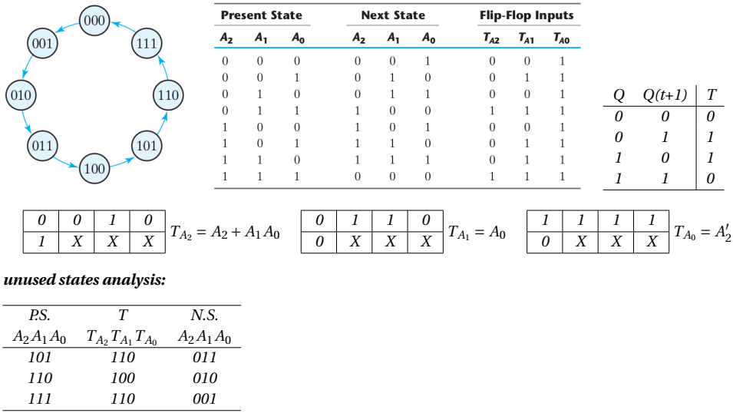
Using a T FF, design a circuit that counts from 4 to 4 and check for unused states

Slide 14
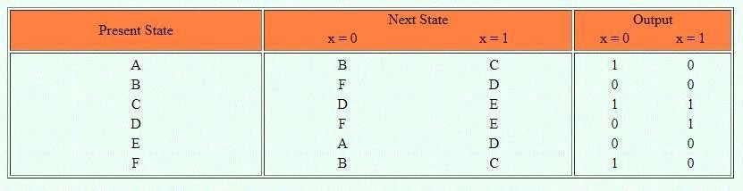
STATE REDUCTION
State Reduction
Any design process must consider the problem of minimising the cost of the final circuit. The
two most obvious cost reductions are reductions in the number of flip-flops and the number of gates.
The number of states in a sequential circuit is closely related to the complexity of the resulting circuit. It is therefore desirable to know when two or more states are equivalent in all aspects. The process of eliminating the equivalent or redundant states from a state table/diagram is known as state reduction.
Example: Let us consider the state table of a sequentialcircuit
State table

Slide 15
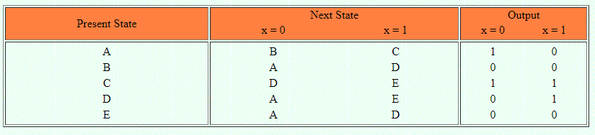
STATE REDUCTION
It can be seen from the table that the present state A and F both have the same next states, B (when x=0) and C (when x=1). They also produce the same output 1 (when x=0) and 0 (when x=1). Therefore states A and F are equivalent. Thus one of the states, A or F can be removed from the state table. For example, if we remove row F from the table and replace all F's by A's in the columns, the state table is modified
State F removed
It is apparent that states B and E are equivalent. Removing E and replacing E's by B's results
in the reduce table

Slide 16
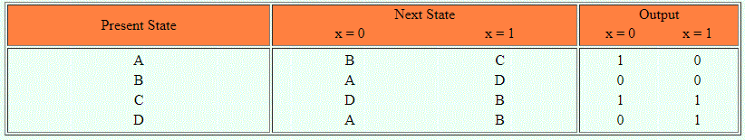
STATE REDUCTION
Reduced state table
The removal of equivalent states has reduced the number of states in the circuit from six to four. Two states are considered to be equivalent if and only if for every input sequence the circuit produces the same output sequence irrespective of which one of the two states is the starting state.

Slide 17
STATE ASSIGNMENT
STATEASSIGNMENT
Each circuit state given in a state table has to be assigned a unique value, which represents combinations of flip – flop output states.
A circuit having 2 internal states requires one flip – flop in its implementation
A circuit having 3 or 4 internal states requires two flip – flops in its implementation
A circuit having 5→ 8 internal states requires three flip – flops in its implementation etc.
It should be noted that although assignments are arbitrary, one assignment might be more
economical than another.
Consider the state table shown below for a circuit having two input pulses x₁, x₂ and a level output Z.
Since the circuit has four internal states then two flip-flops are required. Let the two flip-flop outputs be represented by variables y₁ and y₂, which can have combinations of values y₁y₂ = 00, 01, 11, 10. The state table can then be translated into a state table with secondary assignments as shown. Note that this is just one of many possible assignments (in fact there are 24)

Slide 18
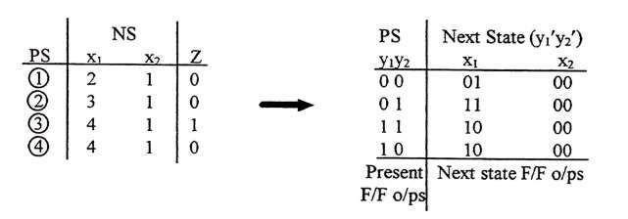
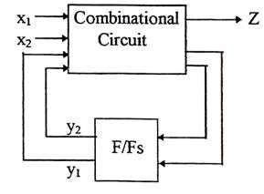
STATE ASSIGNMENT
Example of state assignment
With y₁y₂ =0 (i.e. in state 1), if x₁ is applied then y₁y₂must change to 01 (i.e. state 2). That is, the flip/flop generating y₁ must not disturbed, but the y₂generating flip-flop requires an input such that the circuit settles in state 2, (for example a SET input if using SR flip-flops).

